Slide 1

Lecture – 11/15/2016
CSCI 36300 – Software Design

Slide 2
Assignment #4 Overview

Slide 3
Composite Pattern
Compose objects into tree structures to represent part-whole hierarchies.
Composite lets clients treat individual objects and composition of objects uniformly.

Slide 4
Visitor Pattern

Slide 5
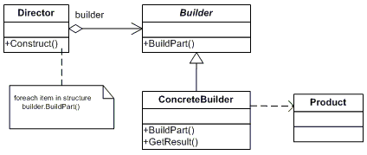
Builder Pattern

